Slide 1
DEVOPS
TEAM - 4
Aryan sahoo
Kavana m
Navina J S
Rani Prathyusha Chidaraboina
Rithik GAngadhara

Slide 2
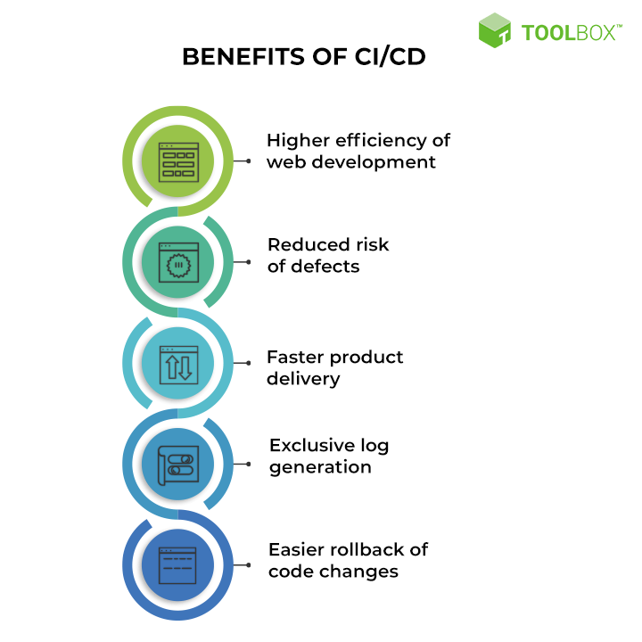
CI/CD PIPELINE
A CI/CD pipeline is an automated process for managing the lifecycle of applications, from development to deployment . CI stands for Continuous Integration and CD stands for Continuous Delivery

Slide 3
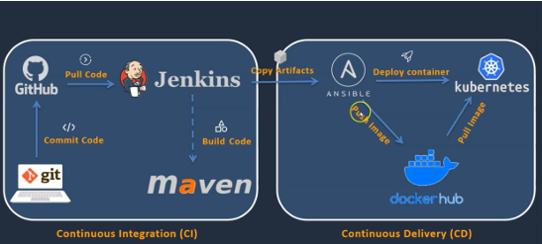
PROCESS
Plugins

Slide 4

GIT
Git is a distributed version control system for tracking changes in source code during software development. It is designed for coordinating work among programmers, but it can be used to track changes in any set of files. Its goals include speed, data integrity, and support for distributed, non-linear workflows.
GIT VS GITHUB
Git is a distributed version control system used for tracking changes in source code, while GitHub is a web-based hosting service for Git repositories where you can collaborate, share, and manage your code online.

Slide 5
JENKINS
Jenkins is an open-source automation server that helps automate the parts of software development related to building, testing, and deploying
Developers commit changes to the source code, found in the repository.
The Jenkins CI server checks the repository at regular intervals and pulls any newly available code
The Build Server builds the code into an executable file. In case the build fails, feedback is sent to the developers.
Jenkins deploys the build application to the test server. If the test fails, the developers are alerted.
If the code is error-free, the tested application is deployed on the production server
Jenkins is used to implement Infrastructure as Code practices

Slide 6
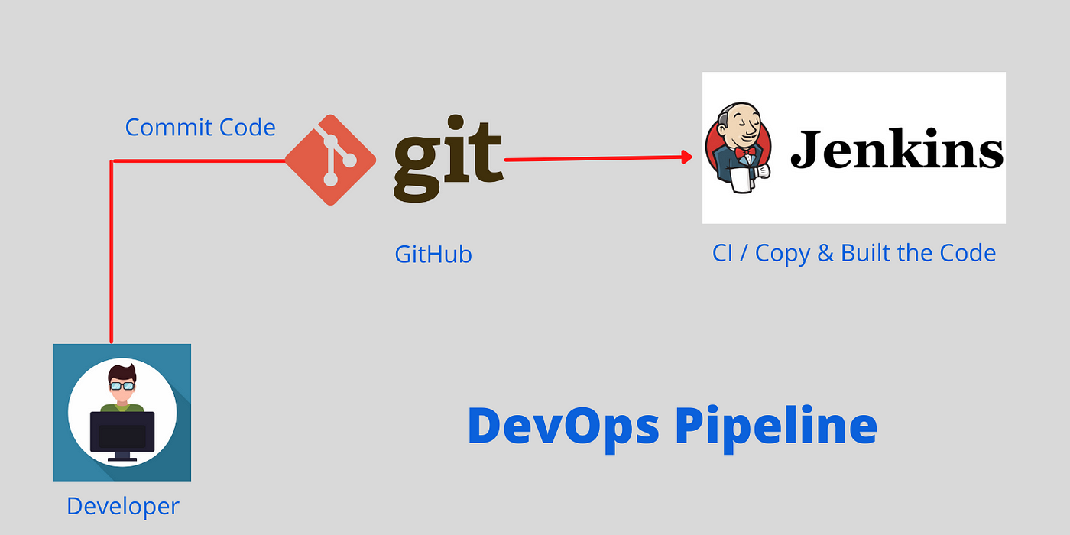
Integrating git with jenkins

Slide 7
MAVEN
Maven is a popular open-source build automation and project management tool primarily used in Java-based development projects.
Features
Dependency management, featuring automatic updating
Backwards compatible with previous versions
Strong error and integrity reporting
Ensures consistent usage across all projects
It’s extensible, and you can easily write plug-ins using scripting languages or Java.

Slide 8
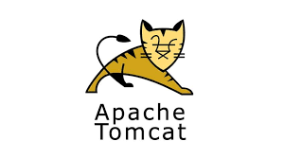
TOMCAT
Tomcat is an open-source web server and servlet. The Apache Software Foundation has developed it. It is used widely for hosting Java-based applications on the web. It is built on Java technologies and implements the Java Servlet and JavaServer Pages (JSP) specifications. Tomcat acts as a bridge between web servers and Java-based applications, facilitating the execution of dynamic content and processing client requests.

Slide 9
DOCKER
Docker is a containerization platform that allows developers to package applications and their dependencies into lightweight, portable containers.
Key concepts:-
Images: Docker images are read-only templates that define an application’s environment. They include the application code, runtime, system libraries, and other dependencies.
Containers: Containers are instances of Docker images. They are lightweight, isolated, and can be started, stopped, and moved between different hosts.
Docker file: A Docker file is a script that defines how to build a Docker image. It specifies the base image, adds application code, sets environment variables, and configures other settings.

Slide 10
What Is Containerization?
Containerization is a technology that allows a developer to package an application and its dependencies into a single container.
Benefits of Containerization
Portability
Isolation
Resource efficiency
Easy to package, ship, and deploy
Enhanced security

Slide 11
ELASTIC CONTAINER REGISTRY
Amazon Elastic Container Registry (Amazon ECR) is an AWS managed container image registry service that provides a secure, scalable, and reliable solution for storing and managing Docker container images.
Components of Amazon ECR:
Registry: Each AWS account has an Amazon ECR private registry. You can create repositories within it to store images.
Authorization Token: Before pushing or pulling images, your client must authenticate to the registry as an AWS user.
Repository: Repositories contain your Docker images, OCI images, and compatible artifacts.
Repository Policy: You can control access to repositories using repository policies.
Image: You can push and pull container images to/from repositories for local development or use in Amazon ECS and Amazon EKS.

Slide 12
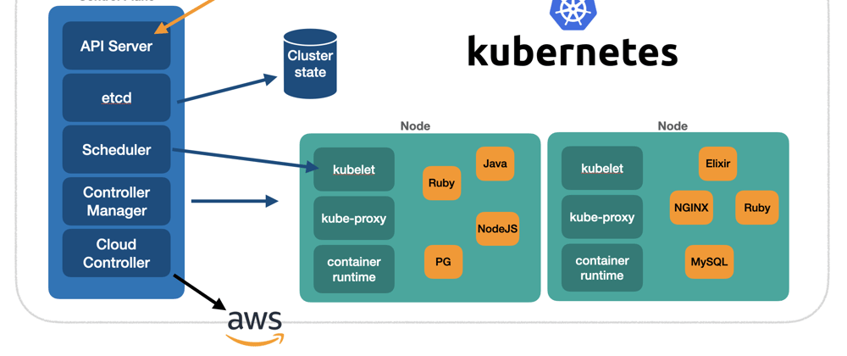
KUBERNETES
Kubernetes, also known as K8s, is a container orchestration platform that follows a master-slave architecture1. It consists of a master node (also known as the control plane) and one or more worker nodes.

Slide 13
Key features of Kubernetes
Automated deployment and management
Scalability
High availability
Improved developer productivity
Cost-effectiveness
Notes:
key features of kubernetes

Slide 14
Step-by-step documentation for the CI/CD pipeline project.
AryanSahoo_10743412_Milestone-2.docx

Slide 15
THANK YOU
………………………………………………………………

